Slide 1
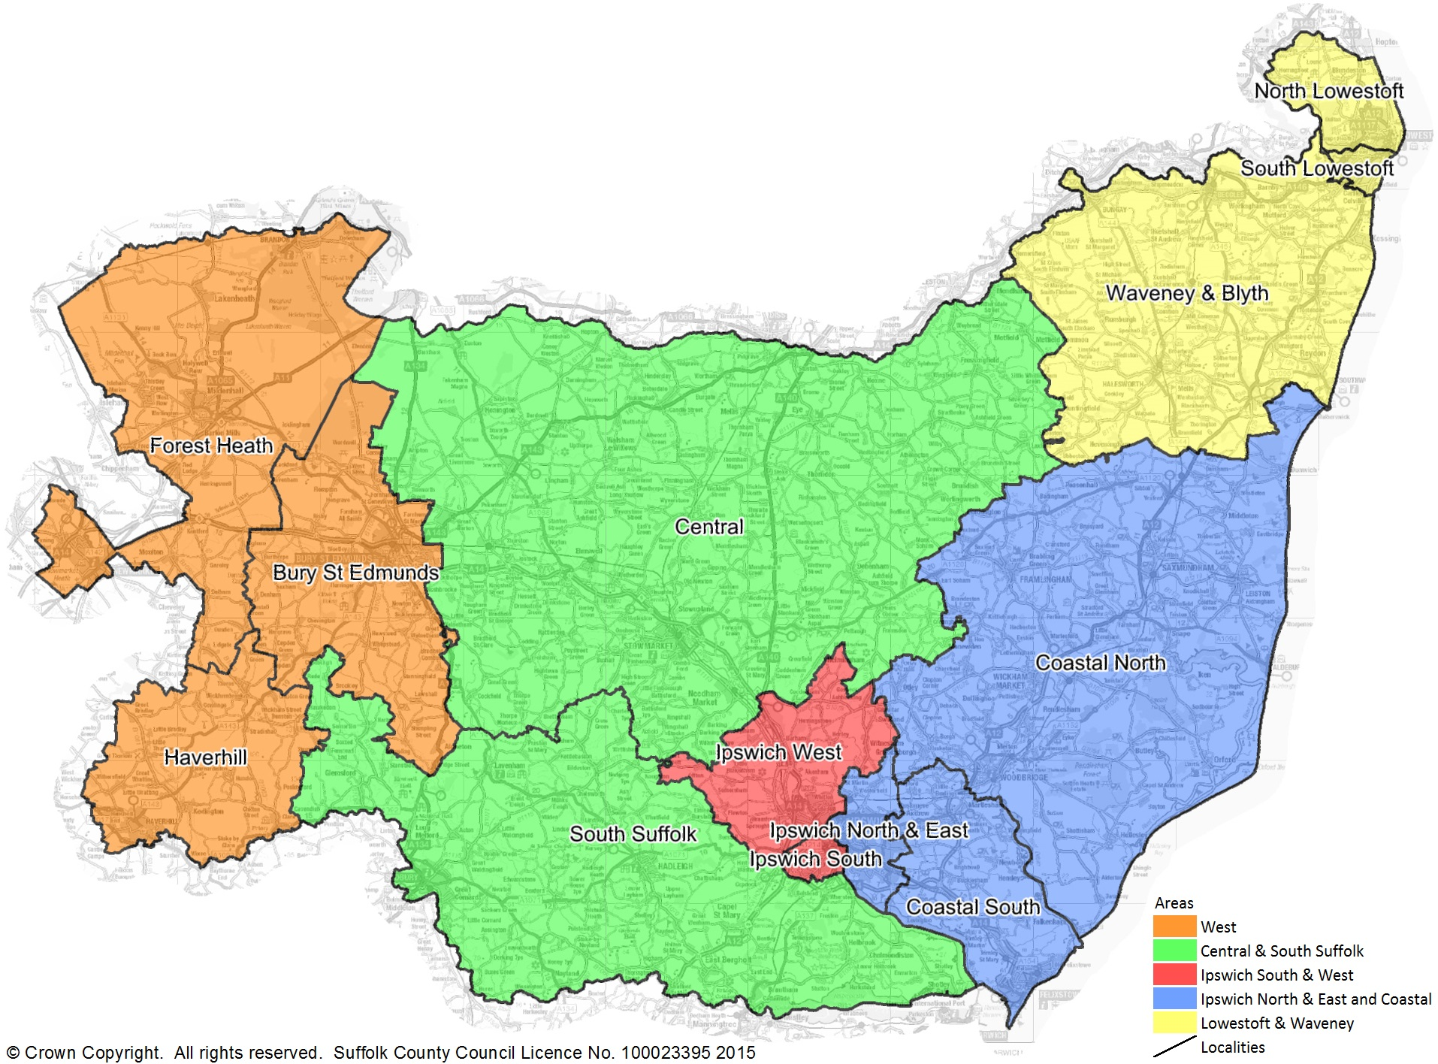
Detailed Map (5 Areas / 13 Localities) Social Care & Early Help Teams

